Slide 1
IMDB Movies Data Analysis using SQL
BY
Name : jenihelan m
Project id : PTID-CDA-MAR-26-1371
Project Code: PRSQL-01

Slide 2
Introduction
This project focuses on analyzing the IMDB Movies dataset using SQL.
The goal is to extract meaningful insights about movies, directors, ratings, and revenue using structured queries.

Slide 3
Objective
Analyze movie dataset using SQL
Perform data cleaning and validation
Extract insights about movies and directors
Visualize data using Power BI dashboard

Slide 4
Data Source
The dataset was sourced from a structured IMDB Movies database provided for SQL analysis.
It consists of two tables:
Movies
Directors

Slide 5
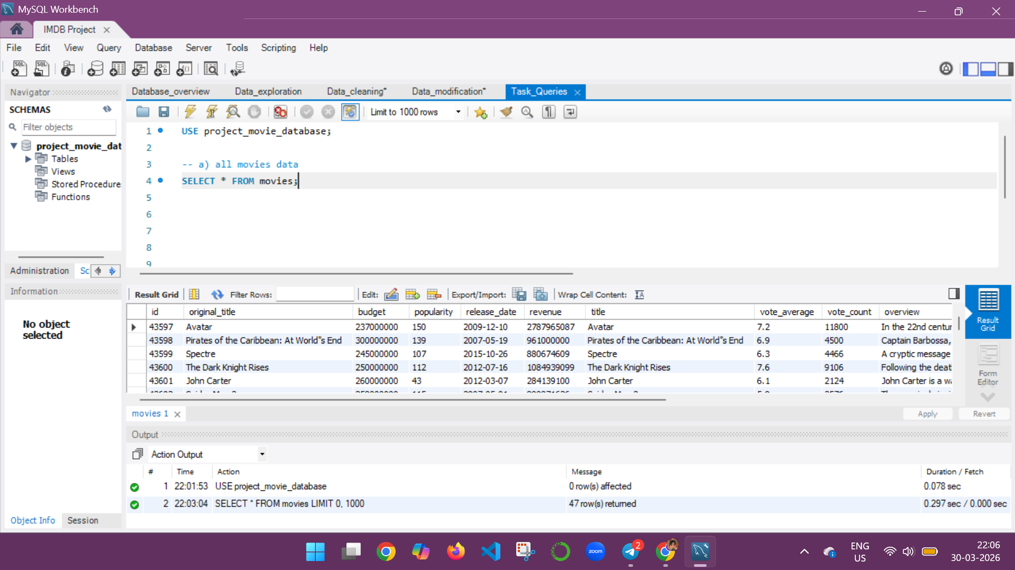
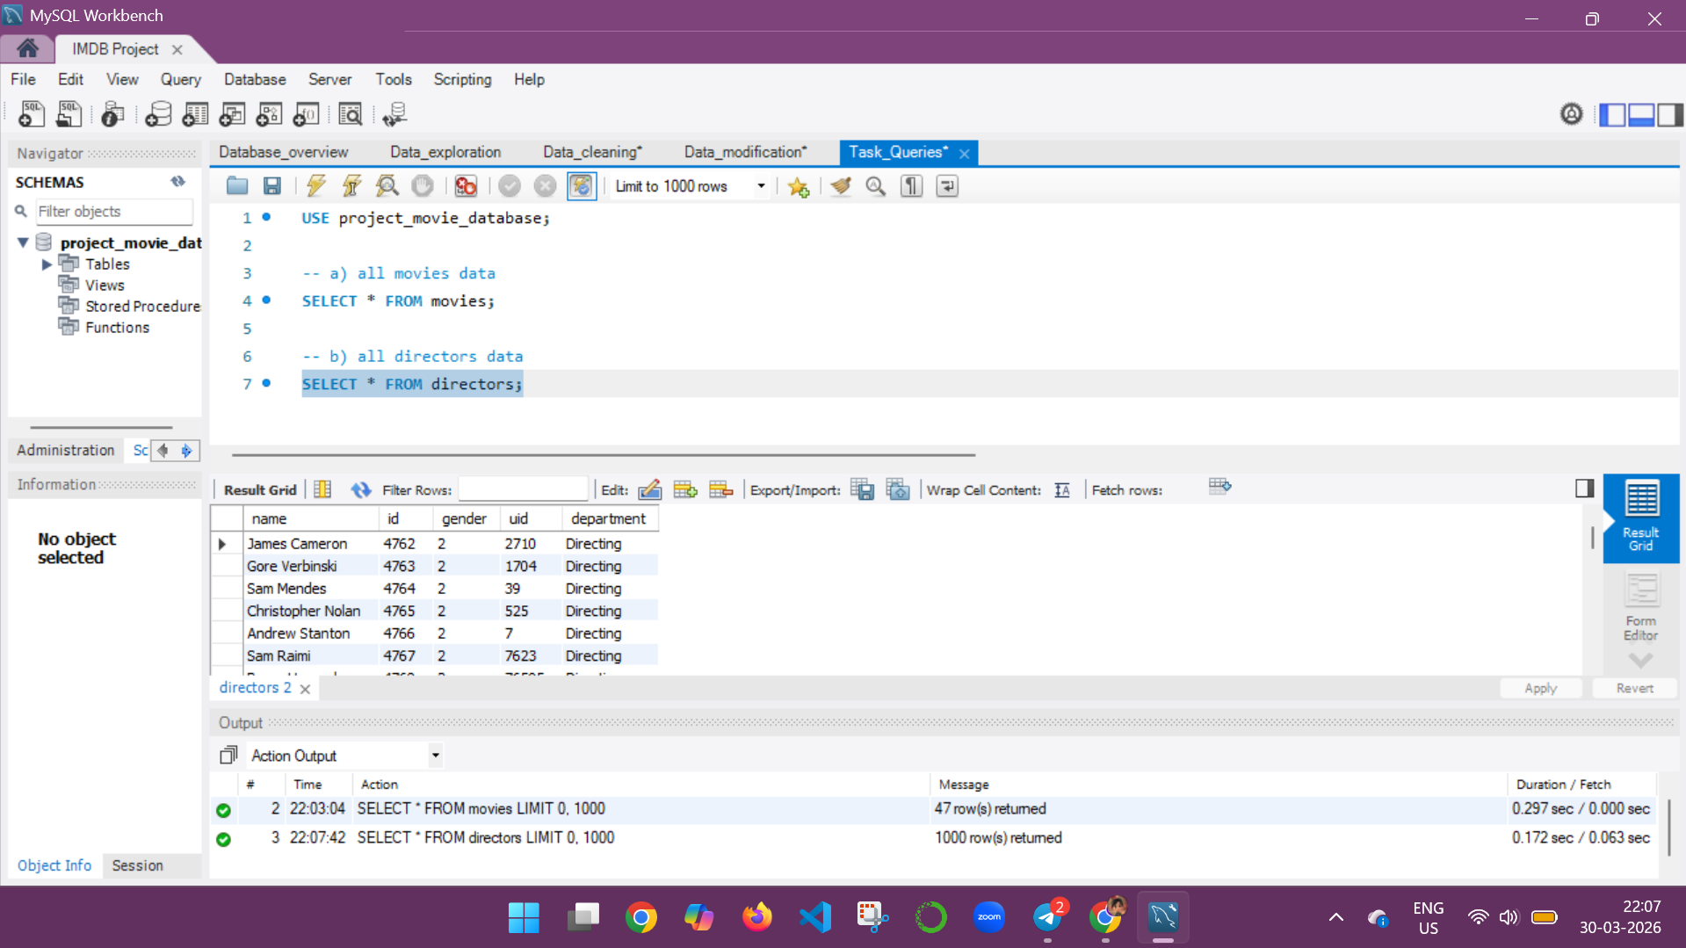
Movies & Directors Table

Slide 6
Dataset Description
Movies Table:
Contains movie details like id, title, budget, revenue, popularity, release date, vote count, vote avg, overview, tagline, director id.
Directors Table:
Contains director details like name, id, gender, department.

Slide 7
Methodology
Connected to MySQL database
Explored dataset structure
Performed data cleaning
Applied SQL queries for analysis
Used JOIN to combine tables
Created Power BI dashboard

Slide 8
Data Cleaning
Checked for NULL values
Identified duplicate records
Verified invalid values
Found NULL values in tagline column

Slide 9
Data Limitation
Unable to perform UPDATE and ALTER operations due to restricted access
Used logical JOIN instead of modifying tables

Slide 10
SQL Analysis
Retrieved movie and director data
Identified top popular movies
Found most bankable movies
Analyzed director contributions

Slide 11
Power BI Dashboard
Created dashboard using live connection
Visualized:
Top 10 Movies by Revenue (Bar)
Top 10 Movies by Popularity (Bar)
Movies Count by Year (Line)
Gender Distribution of Directors (Pie)
Top Directors by Movie Count (Bar)

Slide 12
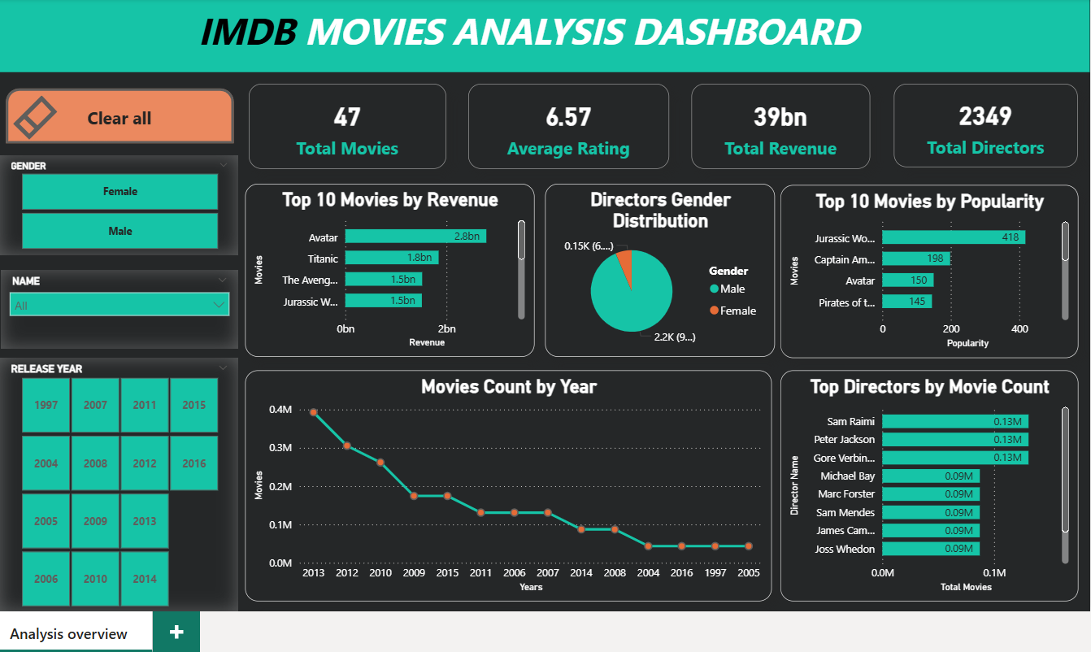
Power BI Dashboard Overview

Slide 13
Results & Insights
Movies show wide variation in popularity (3–418) and revenue (89M–2.78B)
Movie distribution among directors shows slight variation, with a maximum of 3 movies per director and most directors directed only 1 movie.
High revenue does not guarantee high rating
Female directors are fewer.
Older movies have higher ratings (movies released before 2000).

Slide 14
Conclusion
The project successfully analyzed the IMDB dataset using SQL by performing data exploration, cleaning, and query-based analysis.
Meaningful insights were derived regarding movies and directors. Additionally, a Power BI dashboard was created to visually support the analysis and enhance data understanding.

Slide 15
THANK YOU

